Slide 1
Complex Calculator
A cura di:
Tisi Andrea
Salzano Simone
Montervino Dario
Spremulli Michele

Slide 2

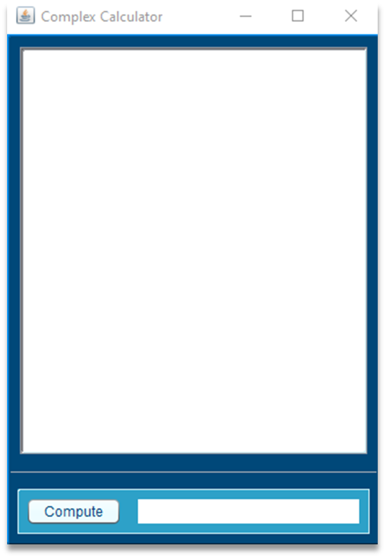
OUR FIRST GUI

Slide 3
OPERATIONS
SUM
SUBSTRACTION
DIVISION
MULTIPLICATION
SQUARE ROOT
SIGN INVERSION

Slide 4
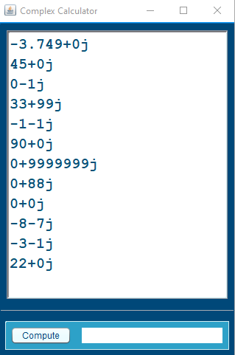
MEMORY
Take a quick glance at the last twelve elements in the memory!!

Slide 5
LET’S TRY THIS

